Slide 1

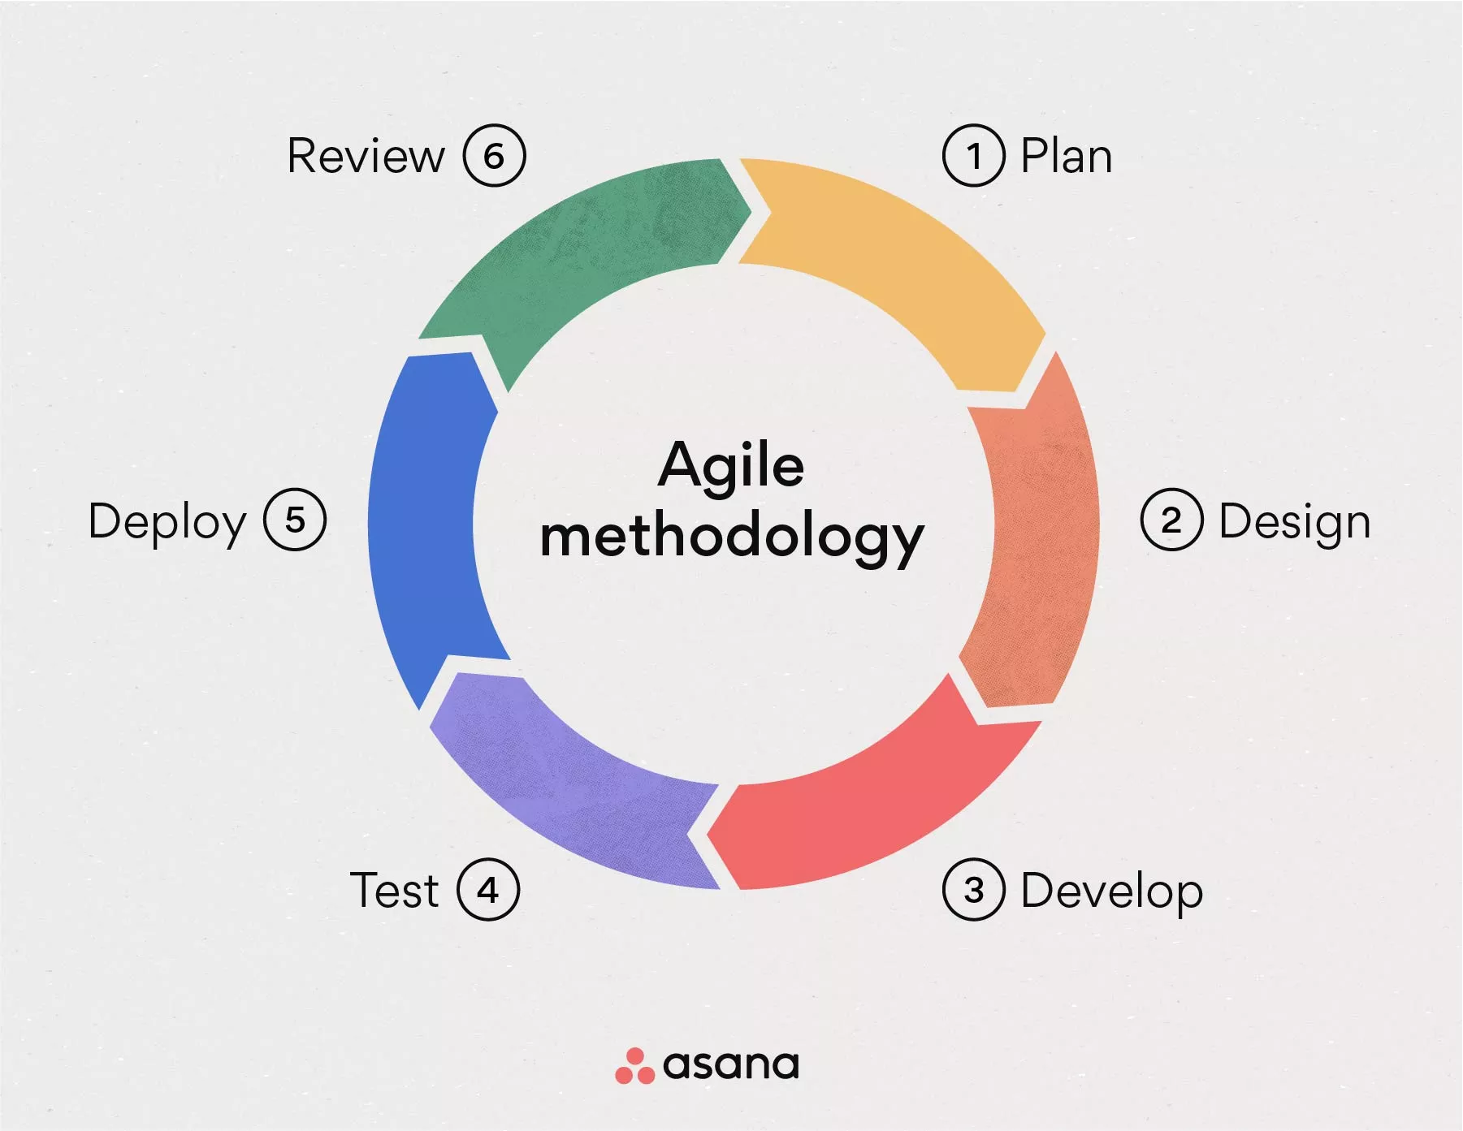
Agile Methodology
By: Jason Barry
Agile Methodology
What Is Agile Methodology? (A Beginner’s Guide) [2023]

Slide 2
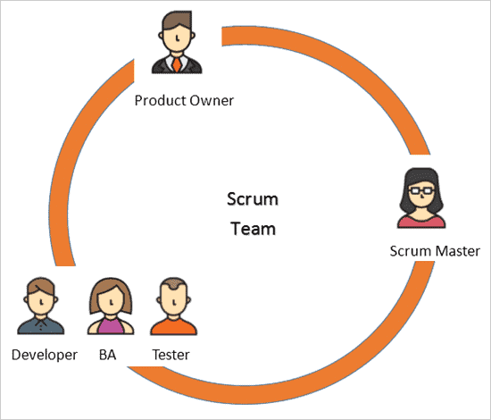
Roles of a Scrum-Agile Team
Product Owner:
Responsible for managing and prioritizing the Product Backlog
Uses collaborative tools like Jira Software to create User Stories
Regularly meets with Stakeholders to ensure the developed software meets evolving needs
Scrum Master:
Encourages effective communication amongst Team Members
Removes any difficulties which may arise
Plans and facilitates regular meetings including the Sprint Planning Meeting (at beginning of Sprint), Daily Stand-ups (occur daily), and the Sprint Retrospective (at the end of a Sprint)
Development Team:
Responsible for creating and implementing User Stories into the Developed Software
Assists in determining the prioritization of User Stories during the Sprint Planning Meeting
Communicates with fellow Team members
Gets aid from and provides aid to fellow Team Members
Updates Sprint progress within Collaborative Tools like Jira Software
Scrum Roles
Scrum Team Roles and Responsibilities: Scrum Master and Product Owner (softwaretestinghelp.com)

Slide 3

Phases of SDLC Work in Agile
Sprint Planning:
A lengthy meeting that occurs at the beginning of every sprint that provides an opportunity for the Product Owner and the Teams to determine what User Stories will be accomplished during the upcoming Sprint. Once decided, the Team Members work together to determine what tasks are necessary to implement these User Stories.
Daily Stand-Up:
Short, daily, 15-minute meetings that allow Team Members to update their fellow Members on their progress in accomplishing the Sprint objectives.
Also provides an avenue for Team Members to get assistance from fellow Team Members on any issues which may arise.
Sprint Review:
Occurs at the end of every Sprint and primarily consists of the team presenting their work to the Product Owner for review. Because the Product Owner should have already seen the results of the software throughout the Sprint, these meetings are essentially brief, user-acceptance tests.
Sprint Retrospective:
Following the Sprint Review, a lengthier meeting known as the Sprint Retrospective meeting occurs. This meetings provides an opportunity for the Team to reflect on what was learned and/or accomplished during the completed Sprint. Furthermore, these meetings help the team identify what didn’t go well and, by extension, what areas need to be improved as the Team transitions into the next Sprint.
Visualizing a Daily Stand-Up
Daily Standup Meeting: Best Standup Tools and Agile Software (standuply.com)

Slide 4
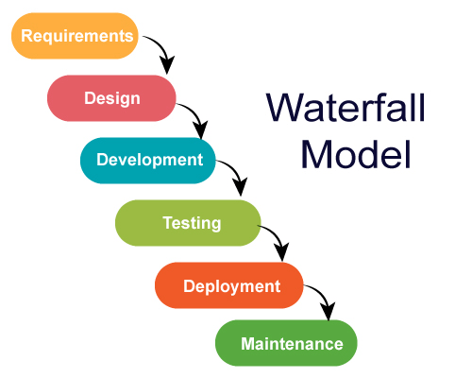
Waterfall vs. Agile
Agile Methodology
What Is Agile Methodology? (A Beginner’s Guide) [2023]
Waterfall Model
Introduction to Waterfall Model of SDLC (Software Development Life Cycle) | by Dhruv Khanna | Medium
Waterfall
Utilizes sequential phases with Rigid Requirements which significantly reduces the involvement of stakeholders.
This is a strict approach that is far less adaptable to change.
Agile:
Focuses on Iterative Development and continuous feedback
This a far more flexible approach that is inherently adaptive to change.

Slide 5
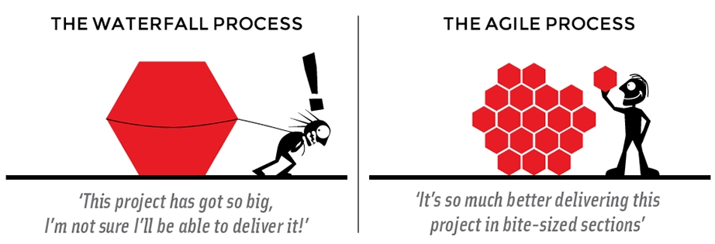
waterfall or agile?
Waterfall:
Useful on well-defined projects that have strict requirements and little Stakeholder involvement. Furthermore, because this process is unable to accommodate change, it is far more useful on short, less complex projects.
Agile:
Useful on projects with evolving requirements and consistent Stakeholder involvement. The Agile methodology sees greater impact on larger, more complex projects because the methodology encourages fast iterations that meet the ever-evolving requirements.
Waterfall vs Agile
Agile Methodology vs Waterfall Model: Pros and Cons (ganttpro.com)

Slide 6
Works Cited
Cobb, C. G. (2015). The Project Manager’s Guide to Mastering Agile: Principles and Practices for an Adaptive Approach. textbook, Wiley.
Daily Standup Meeting: Best Standup Tools and Agile Software. Standuply Journal. (2023, May 11). https://standuply.com/blog/daily-standup-meeting/
Khanna, D. (2021, June 1). Introduction to Waterfall Model of SDLC (Software Development Life Cycle). Medium. https://luciferrocks.medium.com/introduction-to-waterfall-model-of-sdlc-software-development-life-cycle-a01c7ec5e2ef
Laoyan, S. (2022, October 15). What is Agile Methodology? (A Beginner’s Guide) [2023]. Asana. https://asana.com/resources/agile-methodology
Mueller, L., Team, G., Sharma, M., MLPate64, &amp; 6, A. K. (2022, August 25). Agile Methodology vs Waterfall Model: Pros and cons. Gantt Chart GanttPRO Blog. https://blog.ganttpro.com/en/waterfall-vs-agile-with-advantages-and-disadvantages/
Scrum Team Roles and Responsibilities: Scrum Master and Product Owner. Software Testing Help. (2023, June 28). https://www.softwaretestinghelp.com/scrum-roles-responsibilities/

